Slide 1
Traffic Signs Recognation
Ayman Saeid

Slide 2
Context
problem definition
the dataset
training the net (CNN) : CNN.py
training the net (Ranodom Forest) : RandomForest.py
Comparison of the two algorithms
GUI for Traffic Sign Recognition : gui.py ( demo )

Slide 3
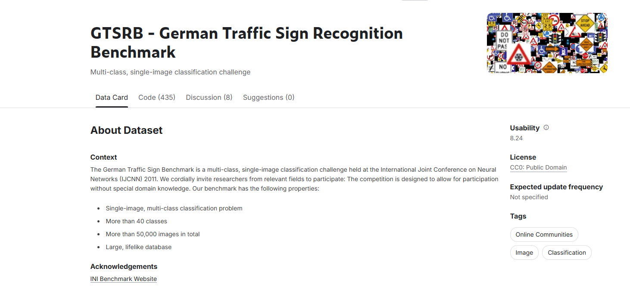
problem definition

Slide 4
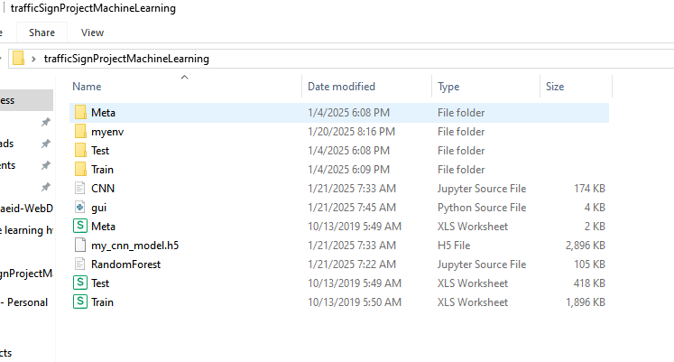
the dataset

Slide 5
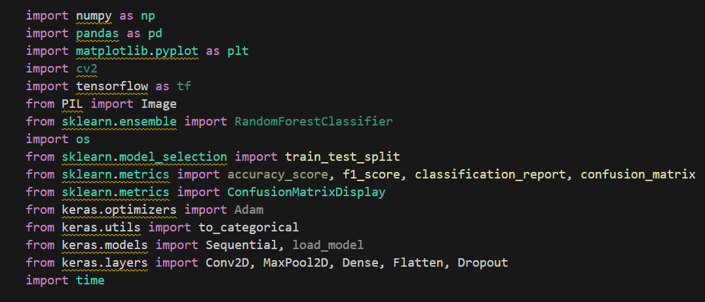
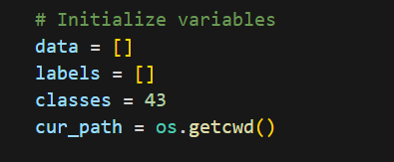
upload data

Slide 6
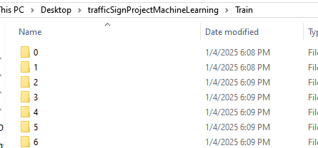
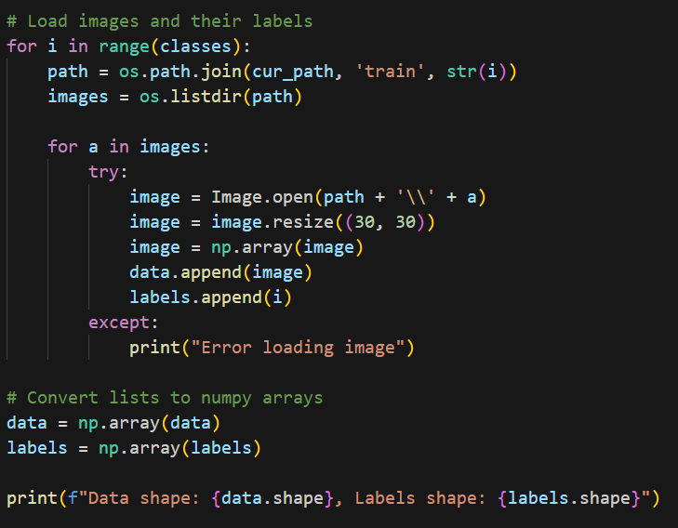
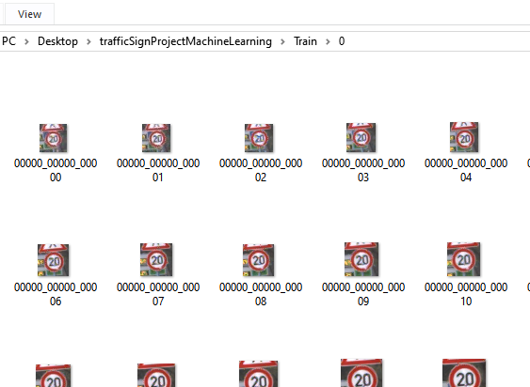
upload data

Slide 7

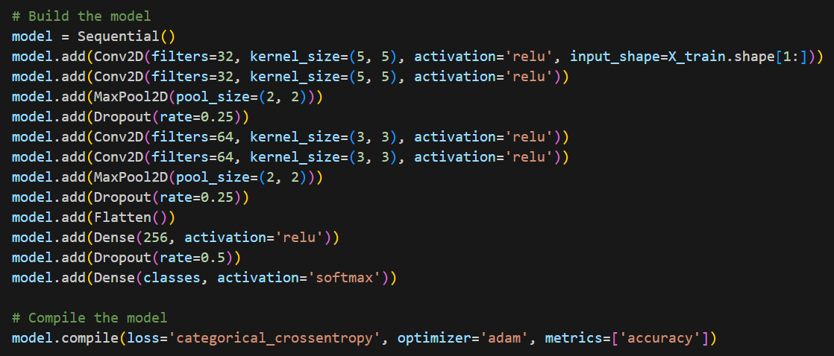
CNN

Slide 8
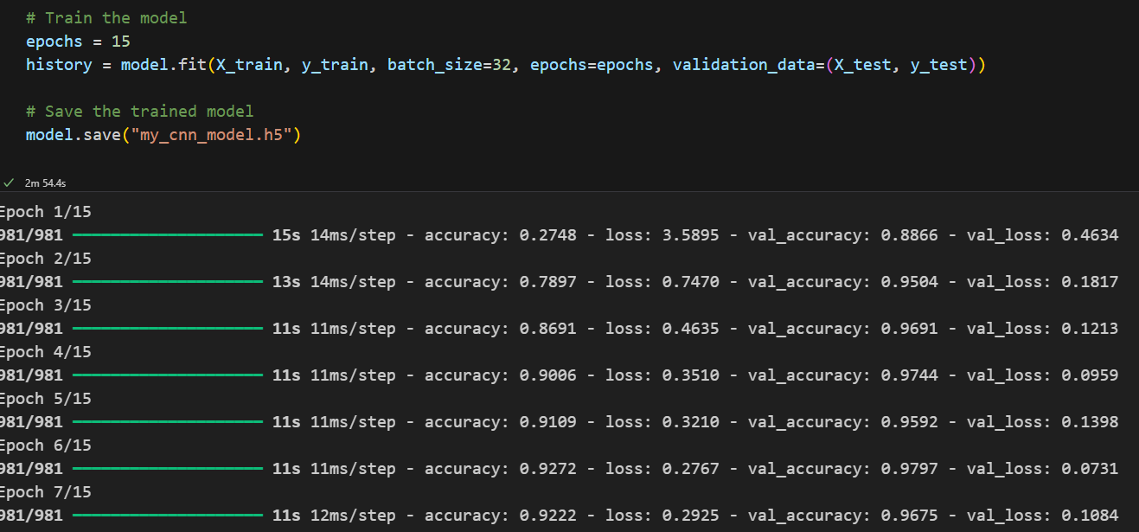
CNN

Slide 9
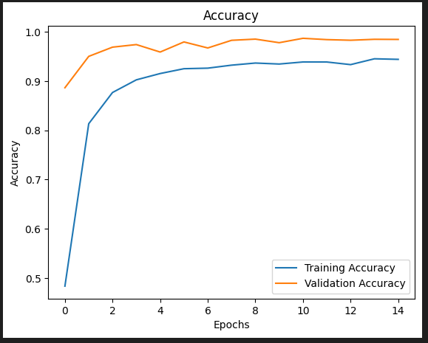
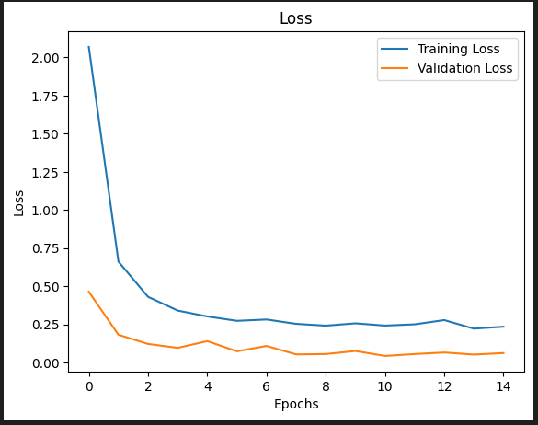
CNN

Slide 10
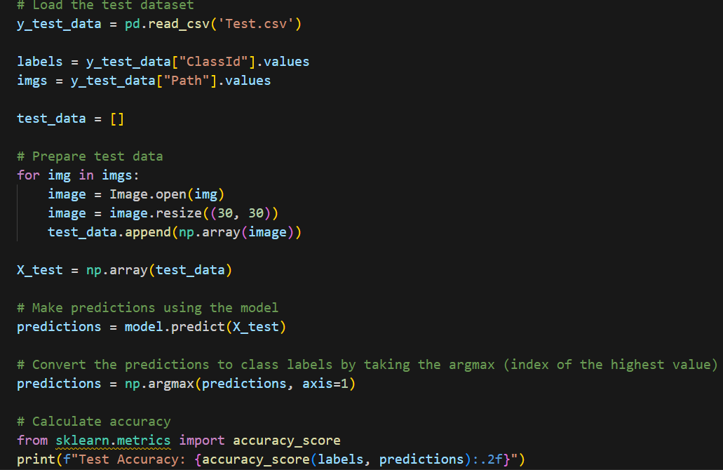
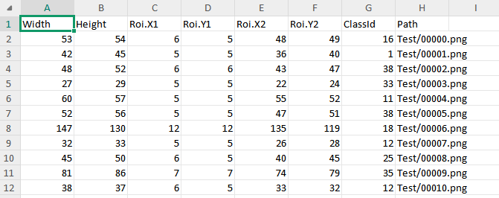

CNN
Test.csv

Slide 11
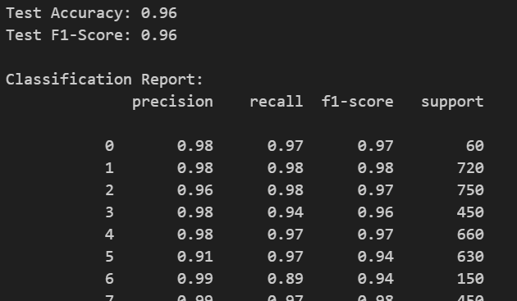
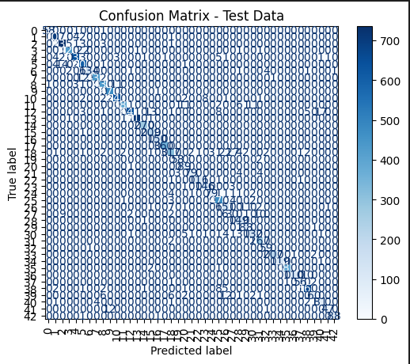
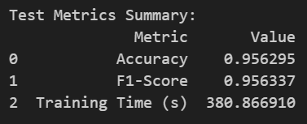
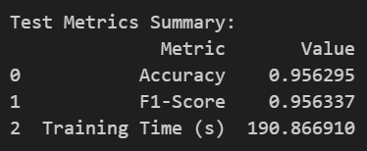
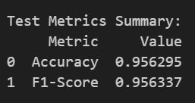
CNN

Slide 12
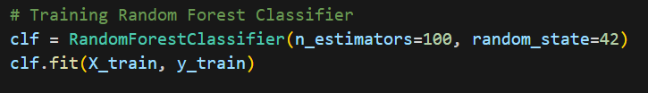
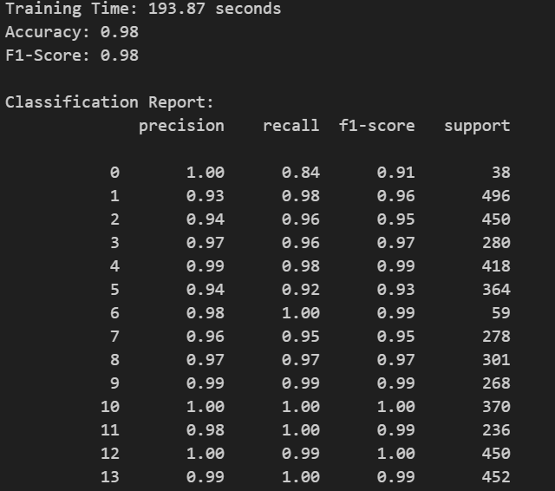

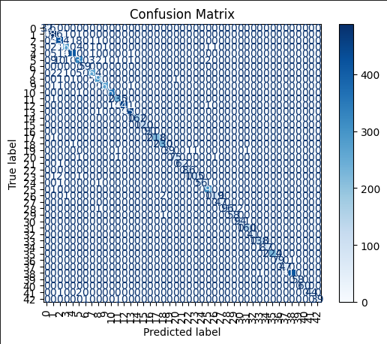
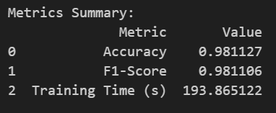
Random Forest

Slide 13
Comparison of the two algorithms
Accuracy (Doğruluk):
Random Forest: %98.11
CNN: %95.63
F1-Score:
Random Forest: %98.11
CNN: %95.63
Time complexity :
Random Forest: 193.87 seconde
CNN: 380 seconde

Slide 14
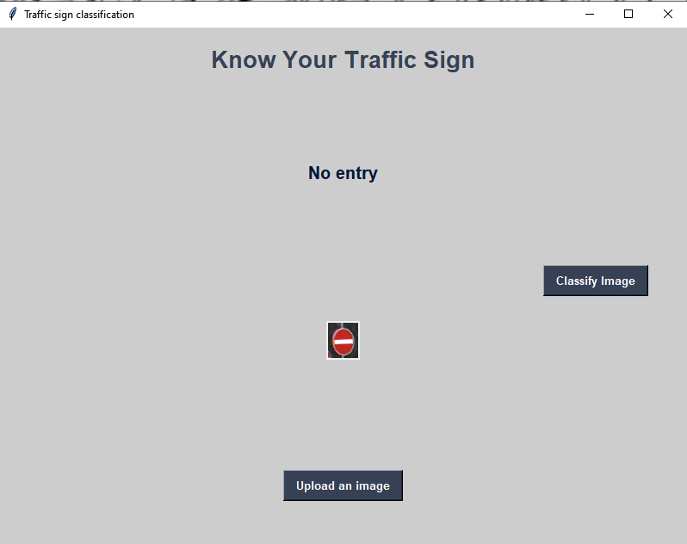
DEMO

